Slide 1




Getting Started with Visual Studio Code
by Goodness Adewuyi

Slide 2

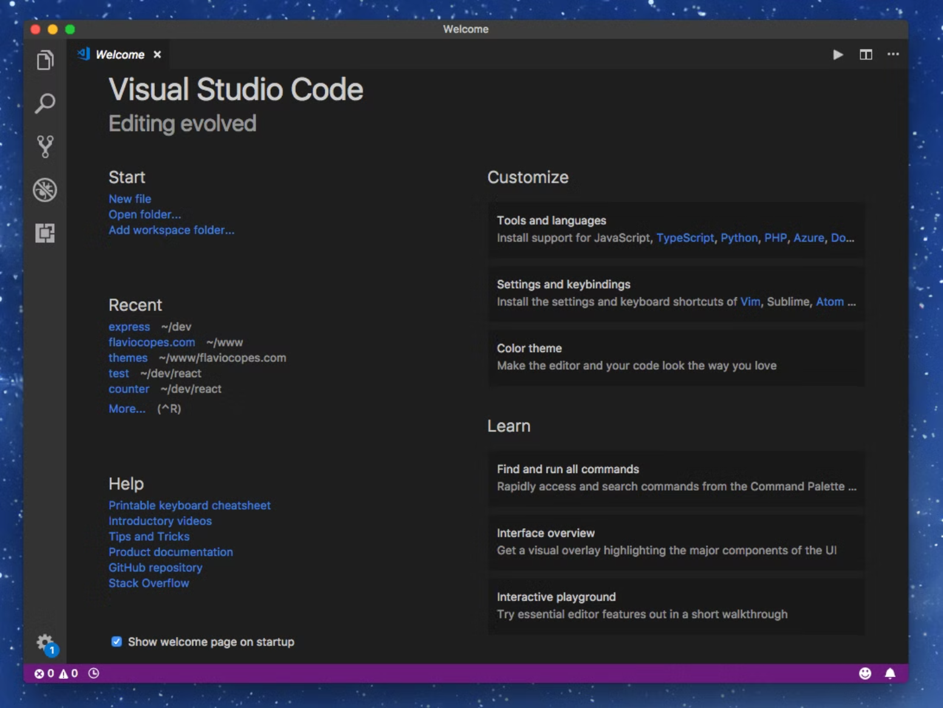
Introduction to VS Code
VS Code: powerful, versatile code editor.
Boosts productivity for developers.
Extensible with many integrations.

Slide 3






System Requirements
Windows
macOS
Windows 8.1 or later.
macOS Sierra 10.12+.
Linux
CPU
Debian, RedHat, Ubuntu.
1.6 GHz or faster.
RAM
Storage
1 GB RAM minimum.
200 MB disk space.

Slide 4


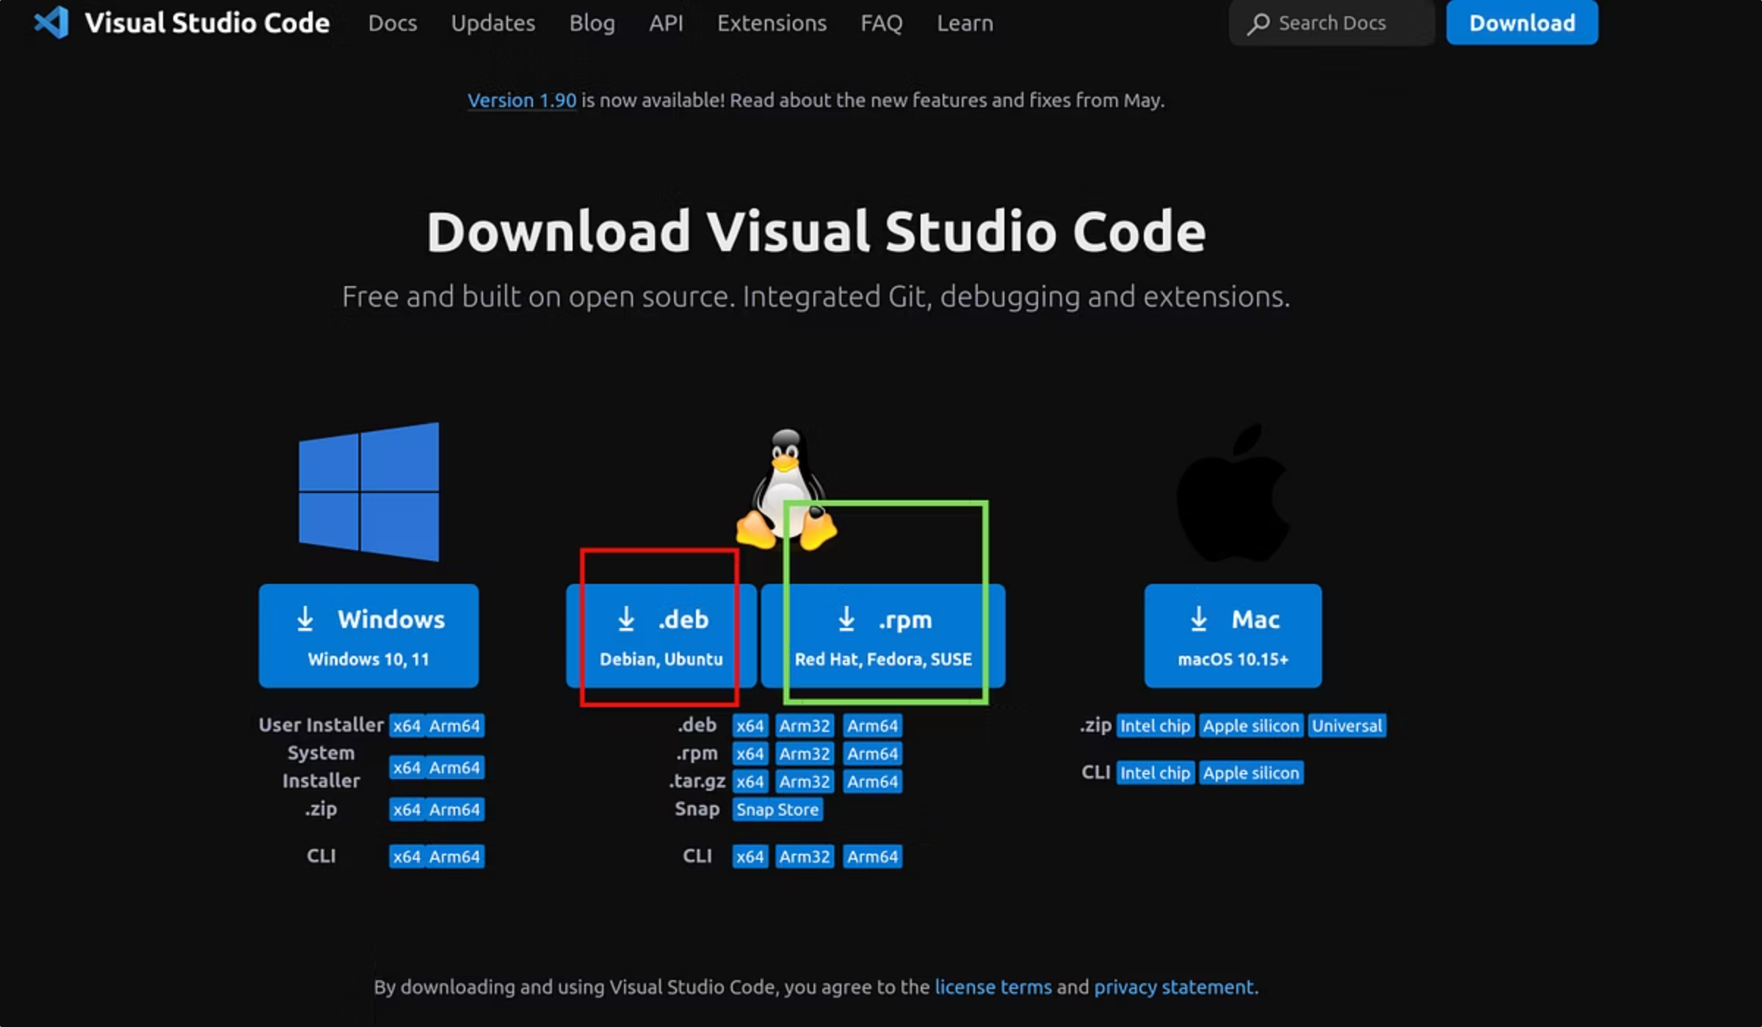


Downloading VS Code
Visit Website
Go to official VS Code site at;
https://code.visualstudio.com/download
Select Download
Choose your operating system(Windows, MacOS or Linux)
Start Download
File downloads automatically.

Slide 5


Installing VS Code
Follow installer prompts for quick setup.
Accept license, choose install location.
Desktop icon option available.

Slide 6
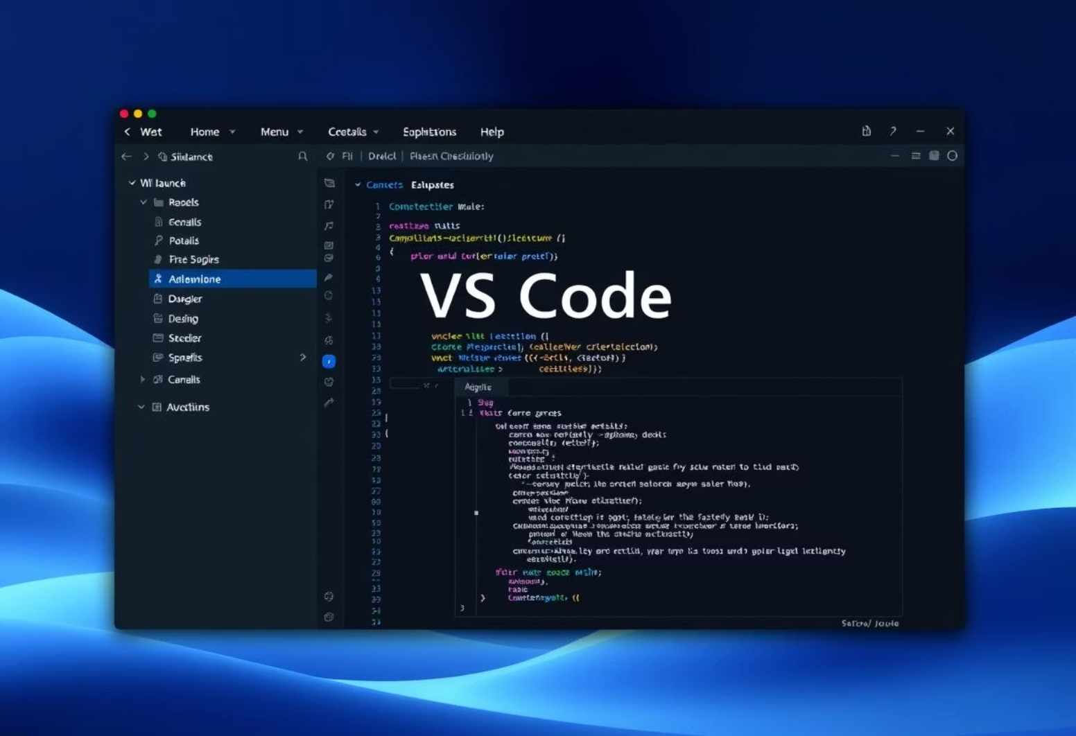
Launching VS Code
Welcome screen appears first.
Explore sidebar for files.
Menu bar for main options.
Terminal panel for commands.

Slide 7
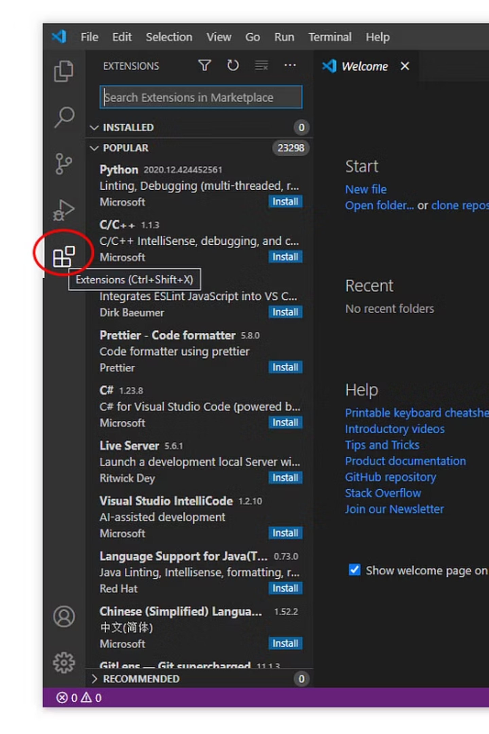
Installing Extensions
Extensions Tab
Access via sidebar icon.
Search & Install
Find and add plugins it will help in your journey.
For the sake of this project: Live server is an important extension.
Prettier, JavaScript, Git are also great options.

Slide 8
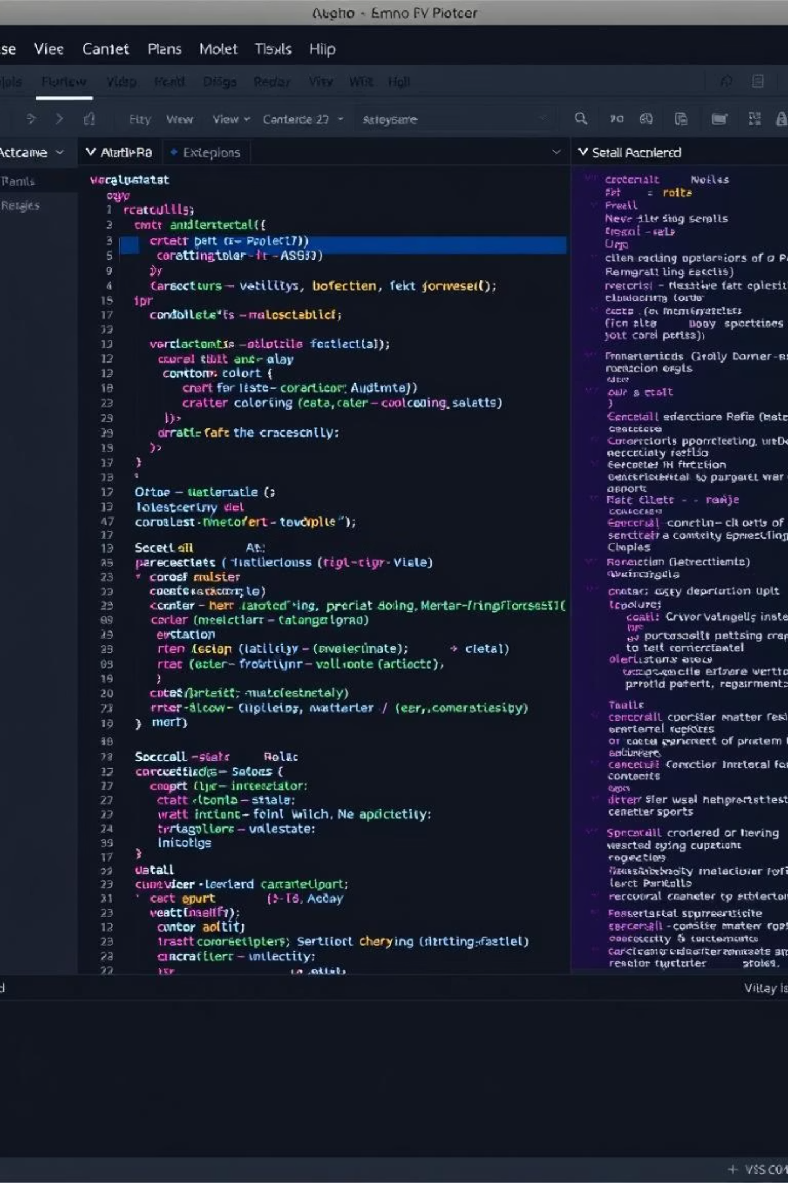



Optional Customizations
Themes
Font Settings
Change code editor colors.
Adjust font size and style.
Git Integration
Version control setup.

Slide 9

Summary: You're All Set!
Download & Install
Get VS Code on your system.
Launch & Explore
Familiarize with interface.
Add Extensions
Enhance functionality.
Customize
Personalize your setup.

